Slide 1
NFU Progress Report
2023/06/10
NFUIM

Slide 2
Outline
Current progress (Finished)
Method
Results
Explanation

Slide 3
Current progress (Finished)
Check if the US stock market is open (considering EST and EDT).
Calculate the threshold of volume.
Identify the days that meet the criteria for trading.
Calculate the profit ratio.

Slide 4
Method
Our Parameter:
n_day = 90
n_percentile = 0.95
n_time = 0h 0m 0s
n% = 5
Preprocess the data using the information provided by CCU.
Address the issue of time zones.
Calculate the threshold of volume using n_day (90) as a parameter. Determine which days meet the condition of n_percentile (95).
Within n_time (From market open to market close) after the market opens, evaluate the condition:
Formula = “[now_price > open_price * (1 + n%)] or [now_ price < open_price * (1 - n%)]”
If the condition is met, initiate a reverse operation and conclude the trade at the market close (day trading).
You can configure this parameter (ex: 15 min), but it is not currently set.

Slide 5
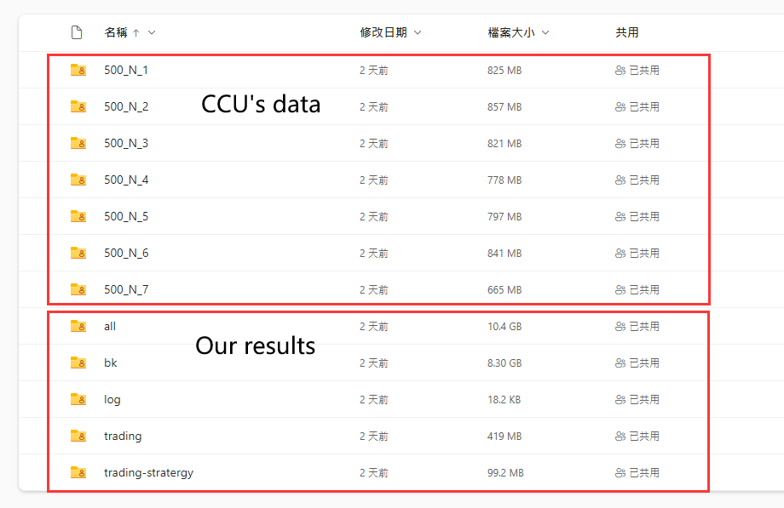
Results
Data
Directory description:
all = Data merging and processing
bk = Backup records from the past (not important)
log = Trading logs, recording the dates of each stock transaction (.txt)
trading = Records of all stock transactions (.csv)
trading-strategy = Records of stocks with trading activity (.csv)

Slide 6
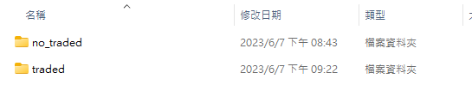
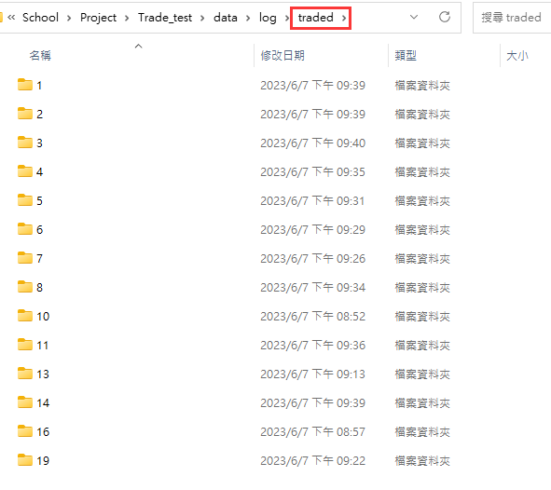
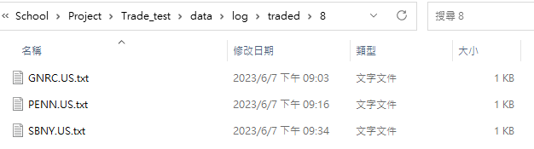
Explanation - log
[1]
[2]
In the "log" folder, you can find two directories named "no_traded" and "traded“[1]. The "no_traded" directory contains stocks that were not traded, while the "traded" directory contains stocks that were traded.
Inside the "traded" folder, the stocks are organized based on the number of trades[2]. For example, if a stock has a total of 8 trades, it will be stored in the “8" directory[3].
[3]

Slide 7
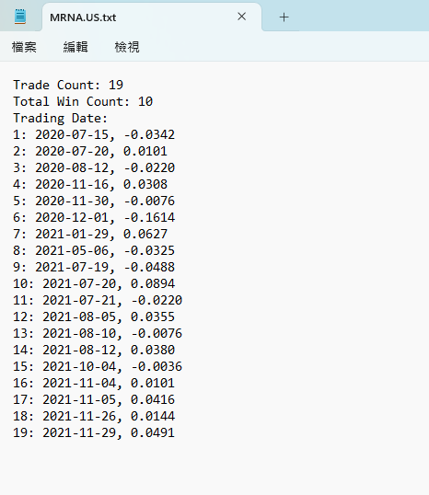
Explanation - log
When you open the document, it will appear as shown in the image on the right.
The document will display the number of trades, the number of profitable trades, the trading dates, and the returns.

Slide 8
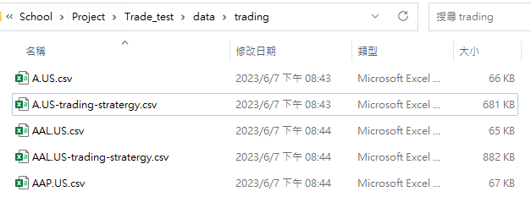
Explanation - trading
The "trading" folder contains the calculation process for all stocks[1]. If the file name is "stock name" (ex: AAL.US.csv), it represents the calculation for the first condition[2]. If the file name is “stock name-trading-strategy” (ex: AAL.US-trading-strategy.csv), it represents the simulation process for trading[3].
[1]

Slide 9
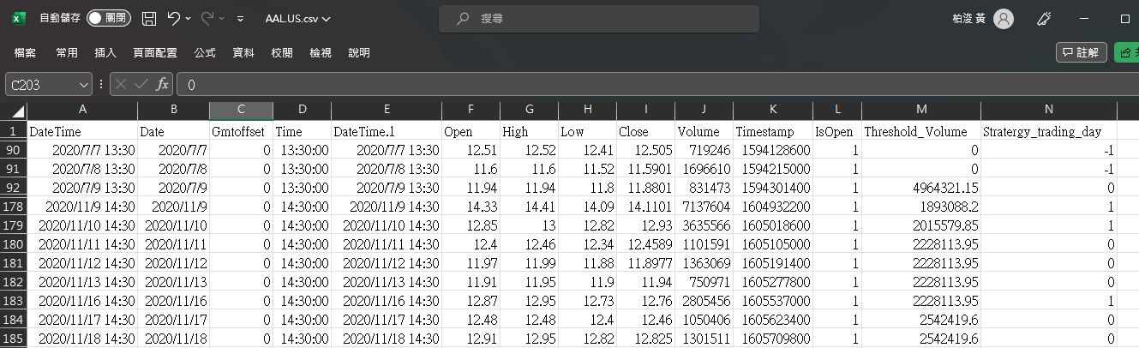
Explanation - trading
[2]
Condition Calculation Process

Slide 10
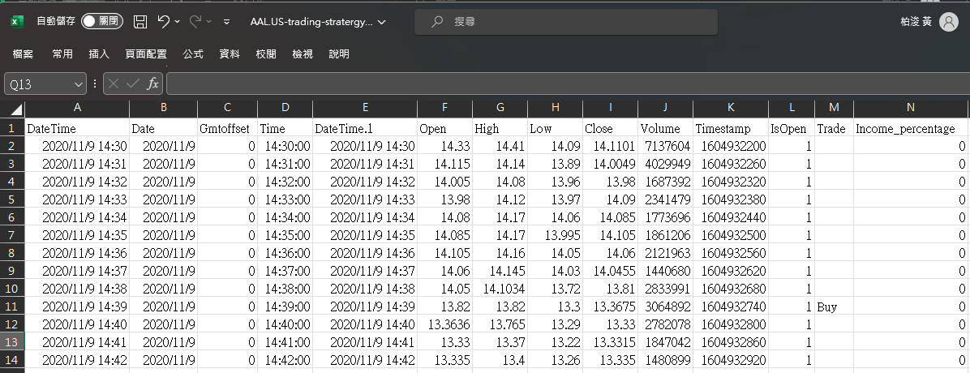
Explanation - trading
[3]
Trading Record

Slide 11
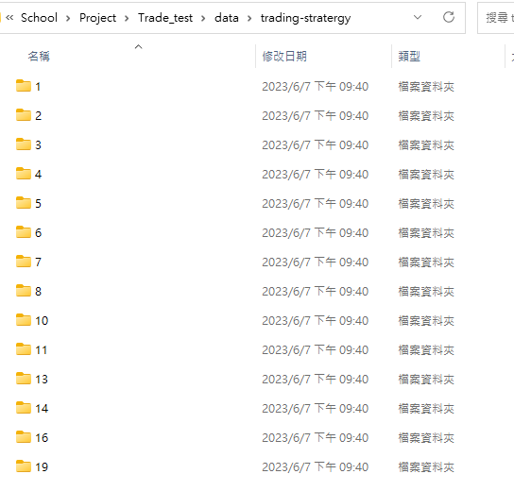
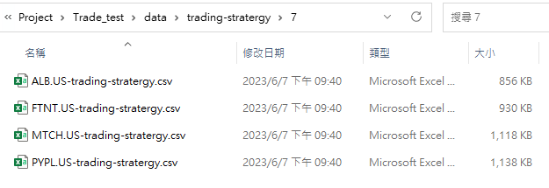
Explanation - trading-strategy
The "trading-strategy" folder stores all the stocks that have been traded and records the trading process. Similar to the "log/traded" folder, it is categorized based on the number of trades.

